Slide 1
Overview of Developments in State Housing Policy
Blueprint for Livable Communities Citizen Advisory Group
July 17, 2015

Slide 2
Overview
Statewide Housing Policy – EO32
Virginia Housing Trust Fund
Homeless Service System
Community Integration for Persons with Intellectual and Developmental Disabilities
National Disaster Resiliency Competition

Slide 3
State Housing Policy
Executive Order 32 issued in October of 2014, directs Secretary of Commerce and Trade to assemble an advisory group to identify and implement actions that enable quality, affordable housing, which will strengthen families and communities and foster economic growth
Policy is to focus on three key areas:
Homelessness, especially veterans and youth
Housing for special needs populations
Linking housing to economic development and community revitalization

Slide 4
State Housing Policy
Advisory Council is composed on a diverse group of leaders from across Virginia
Held first meeting in March and scheduled to meet again in early September
First action was to commission a research study to document the impact of housing on the broader state economy, the importance on housing in the economic development process, and how housing acts as a catalyst for community revitalization
Advisory Council will report annually to the Governor on recommendations and findings

Slide 5
Virginia Housing Trust Fund
Reduce the cost of homeownership and rental housing
Provide continued support for efforts to reduce homelessness.
General fund allocation for FY 15 and FY 16
$4 million in each year; combined into one $8 million resource
Virginia Housing Trust Fund Structure and Use Plan - www.dhcd.virginia.gov
Applications due September 3, 2015

Slide 6
Virginia Housing Trust Fund Allocation
Loans
Competitive Loan Pool | $5.5M
Comprehensive Neighborhood Revitalization Pilot | $1.5M
Grants
Homeless Reduction Competitive Grant Pool | $1.0M
Administration | $160,000
Total | $8.16M

Slide 7
VHTF Key Provisions
At least 80 percent of the Fund must be used as flexible financing for low-interest loans through eligible organizations.
Up to 20 percent of the Fund may be used for grants for targeted efforts to reduce homelessness
Loans structured to maximize leveraging opportunities and are repaid to the Fund
Strong link back to state housing policy

Slide 8
VHTF Competitive Loan Pool
Eligible uses for this 80 percent include:
Affordable rental housing – new construction, rehabilitation, acquisition
Down payment and closing cost assistance for homebuyers
Short, medium and long term loans to reduce the cost of homeownership and rental housing

Slide 9
VHTF Homeless Reduction Grants
Up to 20 percent of the Fund may be used for grants for targeted efforts to reduce homelessness, including:
Temporary rental assistance, not to exceed one year
Housing stabilization services in permanent supportive housing
Mortgage foreclosure counseling – targeting localities with the highest foreclosure rates
Pre-development assistance for permanent supportive housing and long-term housing options for the homeless

Slide 10
Homeless Services System
Transformation since 2010
Move from a strictly shelter-based system to a broader system based on a housing first best-practice model
Shifted funding to rapid re-housing

Slide 11
Homeless Services System
Outcomes focused
Decrease the length of time individuals experience homelessness
Decrease the number of new entries to homelessness
Decrease the number of individuals returning to homelessness
Homelessness should be rare, brief and
non-recurring

Slide 12
Homeless Services System
Focused on Shelters
Focused on Prevention and RRH
Focused on Outputs
Focus on Outcomes
Funding Community-based Solutions
Funding Projects
CoC-based Funding

Slide 13
Homeless Services System
Combined federal and state resources into one program (Virginia Homeless Solutions Program)
Community based application and funding
Organizations must work together at community level to create an effective emergency crisis response system to homelessness

Slide 14
Reduction in Homelessness

Slide 15
Reduction in Homelessness

Slide 16
Reduction in Homelessness

Slide 17
Additional Resources
FY 2016
$500,000 for rapid re-housing
$500,000 for rapid re-housing for veterans (all veterans eligible regardless of discharge status)

Slide 18
Governor’s Coordinating Council on Homelessness
Ending Veteran Homelessness by 2015
Youth homelessness – Interagency Partnership to Prevent and End Youth Homelessness
Performance and Impact – focus on data
Solutions – H² Initiative; intersection of criminal justice system and homelessness

Slide 19
Housing and Supportive Services
Settlement decisions have expanded the reach of Olmstead to state and federal policy
Key Principles in Settlement Agreement:
Reduce unnecessary segregation
Prevent of segregation
(Re) Design systems and access to resources including housing

Slide 20
Housing and Supportive Services
Virginia has a commitment to ensure the intent of the American with Disabilities Act (ADA) and the Olmstead decision.
Launched an intensive community engagement initiative to increase integrated community based housing with supportive services in the communities with the largest number of individuals impacted by the Department of Justice Settlement
Hired a Program Manager to coordinate state agency efforts and serve as point of contact for community efforts

Slide 21
Housing and Supportive Services
100 Day Challenge Model
Focused on Northern Virginia, Hampton Roads, and Greater Richmond
Requires broad participation: CSBs, CILs, RHAs, local governments, nonprofits
Updates, goals, partners, and more available at: www.vahss.org

Slide 22
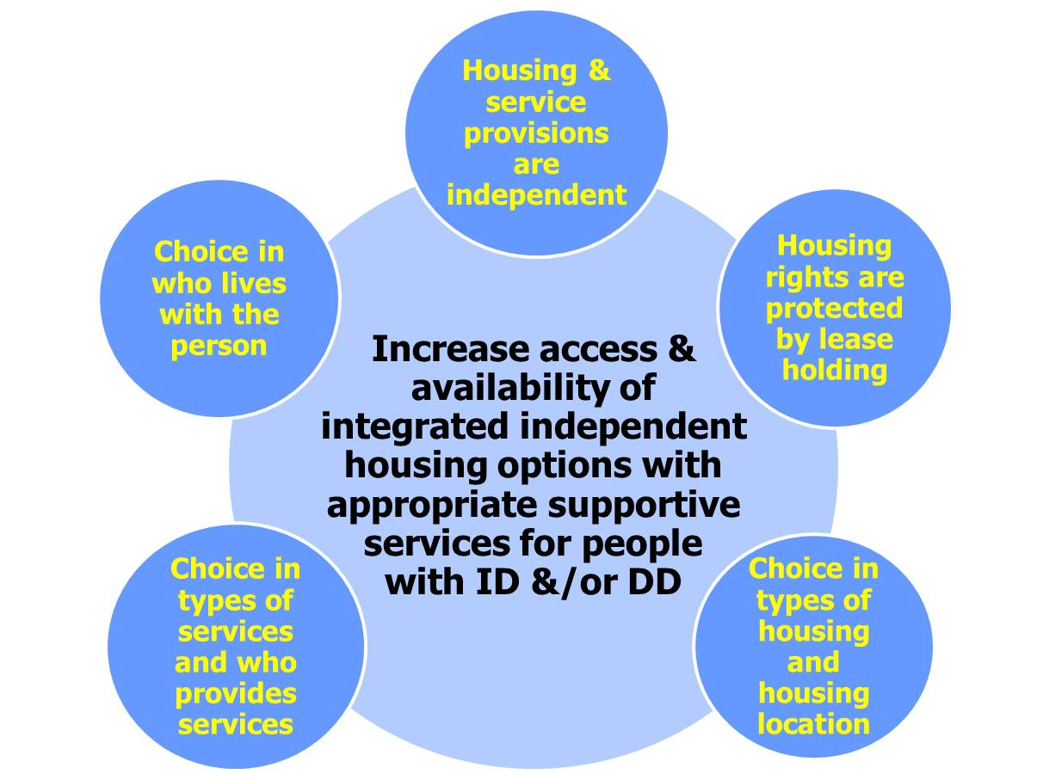
The HSS Challenge/Mission

Slide 23
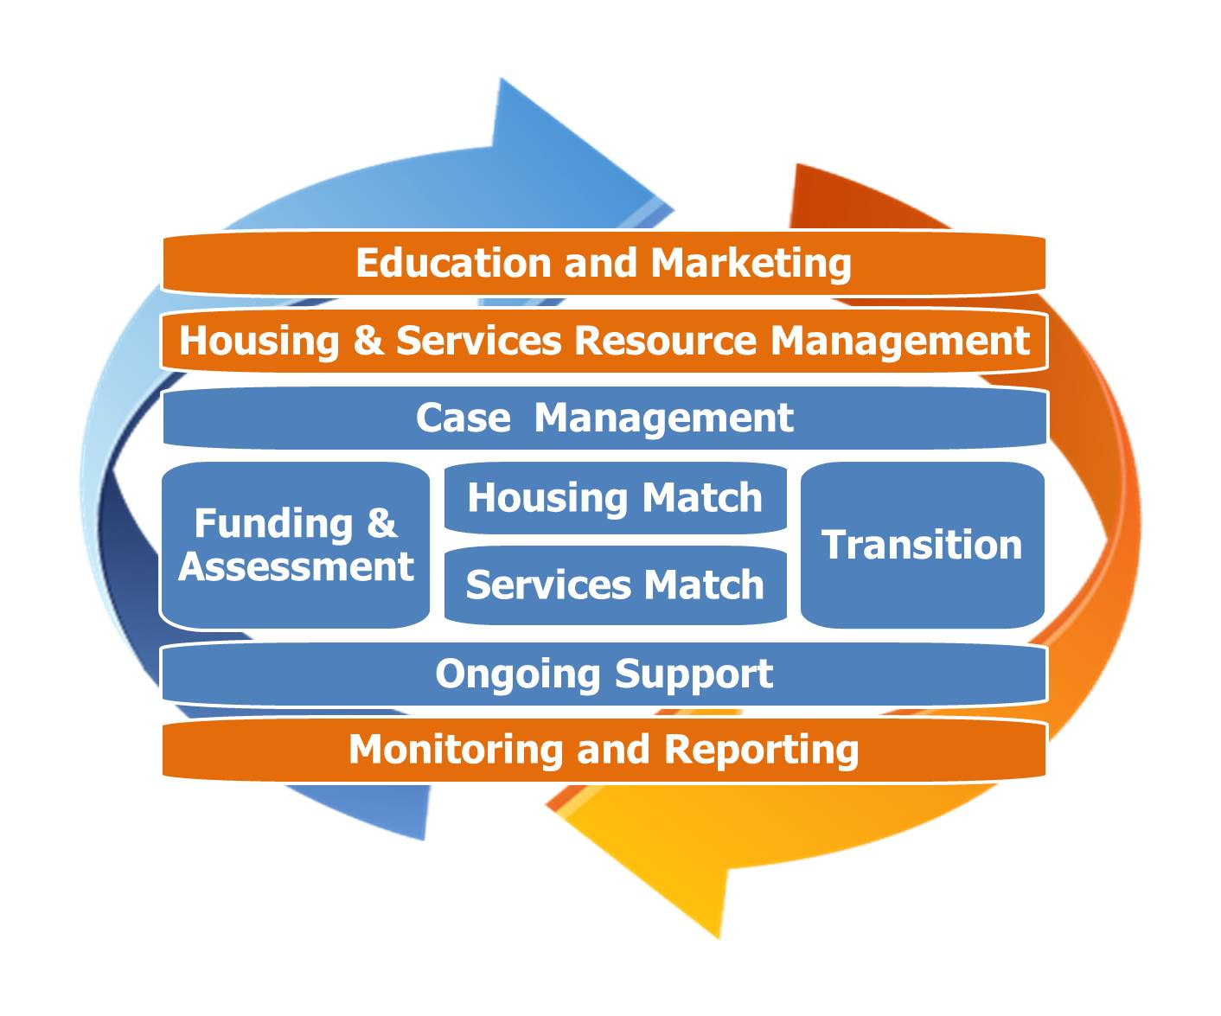
HSS Process

Slide 24
HSS Lessons Learned
Increase community services capacity—
identify supports critical for successful community tenure---align capacity building and investments with what works
Expand the supply of affordable housing
establish a targeting approach as part of the overall effort
Tap into the existing rental market(s)—
establish a marketing strategy

Slide 25
HSS Lessons Learned
Establish a partnership agreement—
build strong alliances
Establish a referral process —
streamline access
Build it and they will come—
inclusion, choice and location matters

Slide 26
National Disaster Resiliency Competition
To provide resources to help communities plan and implement disaster recovery that makes them more resilient to future threats while improving quality of life and making communities more resilient to economic stresses or other shocks.
To fully engage stakeholders about the impacts of climate change and to develop pathways to resilience based on sound science.
To leverage investments from the philanthropic community to help communities define problems, set goals, explore options, and craft solutions.

Slide 27
National Disaster Resiliency Competition
Virginia invited to Phase II – project identification and implementation
The minimum grant award is $1,000,000.
The maximum award is $500,000,000.
Applications due October 27, 2015.

Slide 28
Target Area
Hampton Roads area, to include the Eastern Shore of Virginia.
Qualifying communities include: Cities of Chesapeake, Hampton, Newport News, Norfolk, Poquoson, Portsmouth and Accomack County
Presented best opportunity in terms of available data to demonstrate unmet need.
Numerous prior studies on climate change and sea level rise.
Critical military, economic, and environmental assets.
Norfolk already participating in Rockefeller’s 100 Resilient Cities program.
Ongoing meetings and engagement with localities and potential partners.

Slide 29
Our Purpose
Virginia will surface, test and refine the best strategies for building resilient communities across a range of environments by developing the model seaport region that derives its economic vitality from the water.

Slide 30
Project Goals

Slide 31
Community Engagement
Priority for broad stakeholder participation.
State
Federal
Local
Nonprofits
Community groups
Faith-based organizations
Private businesses (utilities, telcos, more)
Community stakeholders, including residents, businesses, public and private nonprofit agencies, must be engaged in discussing and identifying unmet recovery and resilience needs, and designing and selecting approaches to address the needs.
Outreach activities should target populations that are among the most vulnerable to future threats and hazards, including climate change.

Slide 32
Innovation
Emphasis on innovative design and community involvement.
The Rockefeller Foundation convened resilience workshops around the country and continue to provide technical assistance.
Opportunity to address broad range of activities:
Acquisition
Relocation
Elevation
Infrastructure hardening
Pilot projects
Water management systems
Community communication systems
Research and Development
Economic Development / Business Accelerator
“Pitch” project to other Federal agencies and philanthropic groups.
Replicate.

