Slide 1
DESIGNING HEALTH in VIRGINIA: VIRGINIA as the HEALTHIEST STATE IN THE NATION
Marissa J. Levine, MD MPH
State Health Commissioner

Slide 2
1900
50.6 years
old
2013
78.8 years
old

Slide 4
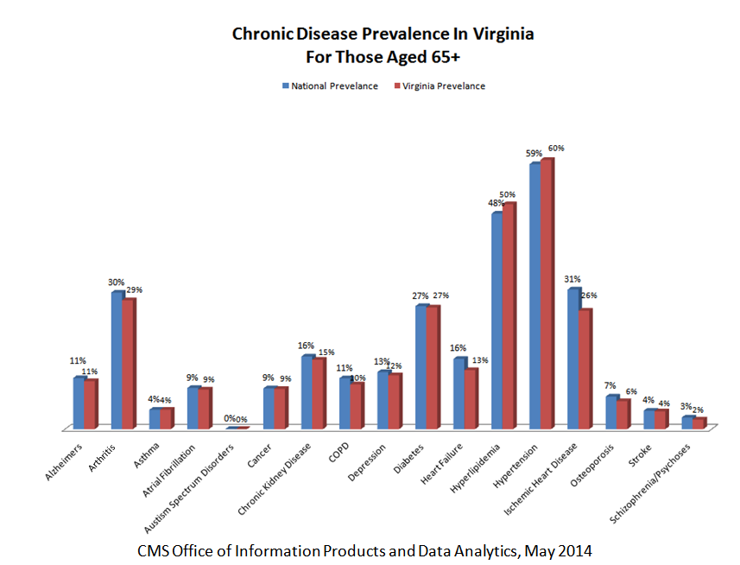

Slide 5
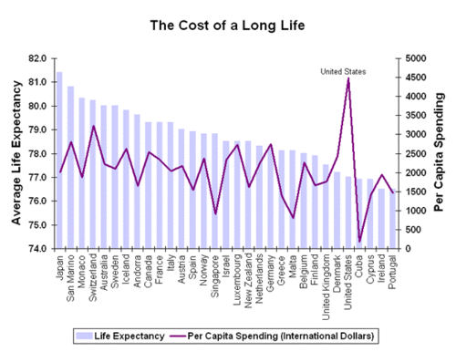
Year - 2000
Source: http://ucatlas.ucsc.edu/health.php

Slide 6
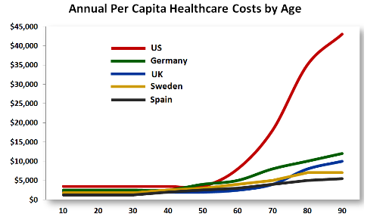
Source: http://www.forbes.com/sites/danmunro/2012/12/30/2012-the-year-in-healthcare-charts/
Notes:
What is different
Higher Costs
Hospital stays
Medications
Surgery
Higher rates
Hospital visits for chronic conditions
MRI use

Slide 7
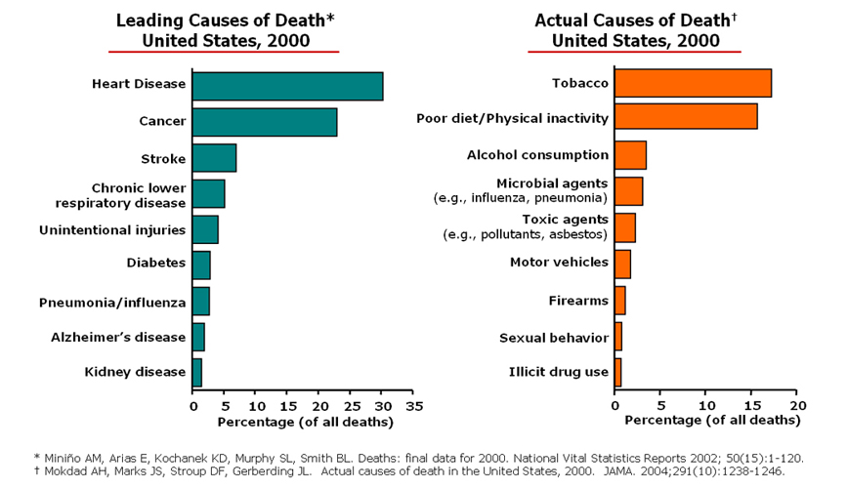

Slide 8
Data Source http://www.cdc.gov/nchs/data/dvs/LCWK9_2013.pdf

Slide 9
Virginians spend $49,427,000,000 per year
on healthcare
Notes:
Total Health Spending includes spending for all privately and publicly funded personal health care services and products (hospital care, physician services, nursing home care, prescription drugs, etc.) by state of residence. Hospital spending is included and reflects the total net revenue (gross charges less contractual adjustments, bad debts, and charity care). Costs such as insurance program administration, research, and construction expenses are not included in this total.
Health Spending Per Capita includes spending for all privately and publicly funded personal health care services and products (hospital care, physician services, nursing home care, prescription drugs, etc.) by state of residence (aggregate spending divided by population). Hospital spending is included and reflects the total net revenue (gross charges less contractual adjustments, bad debts, and charity care). Costs such as insurance program administration, research, and construction expenses are not included in this total.

Slide 10
Leading Causes of Hospitalization in Virginia - 2013

Slide 11
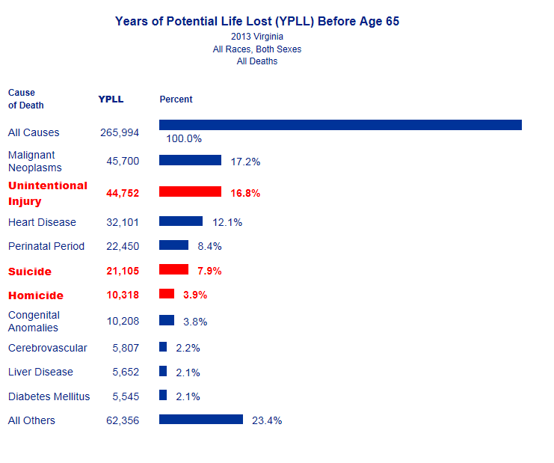
Data Source: | National Center for Health Statistics (NCHS) Vital Statistics System

Slide 12
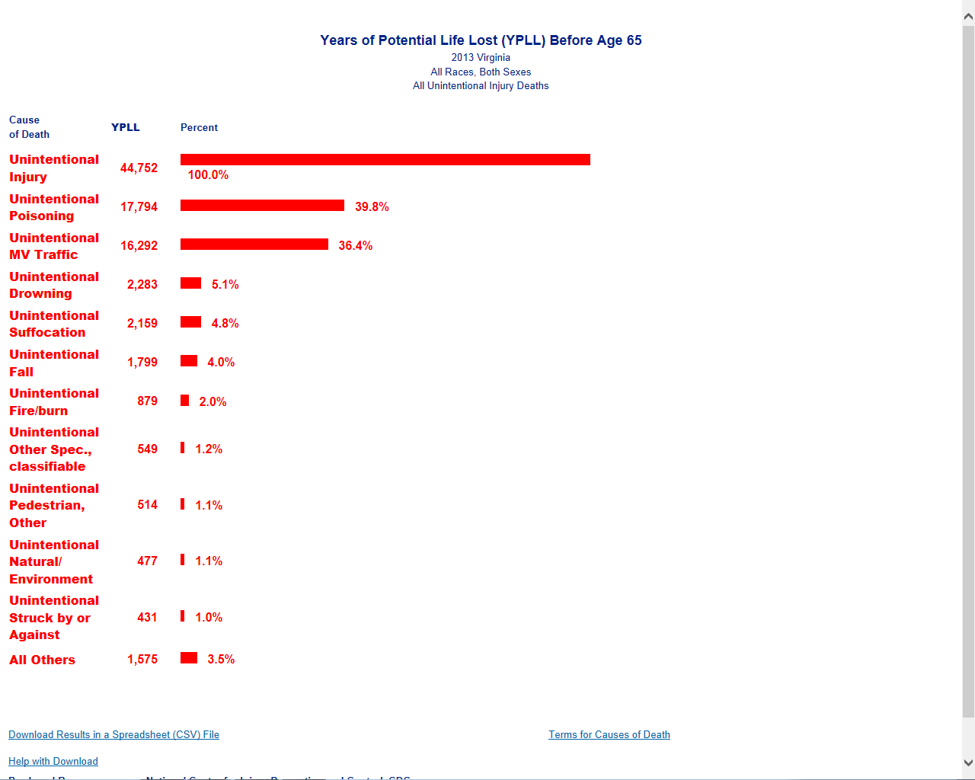

Slide 13
1,159,396
tobacco
users
3,838,092
overweight
or obese
VIRGINIANS

Slide 14
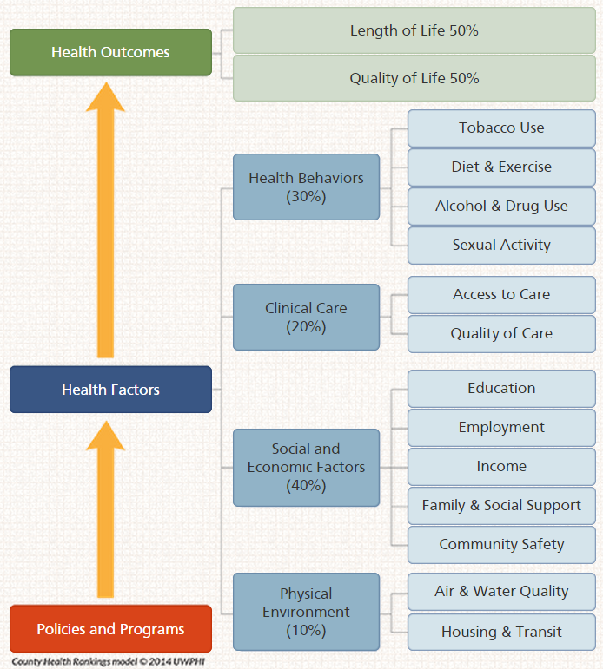
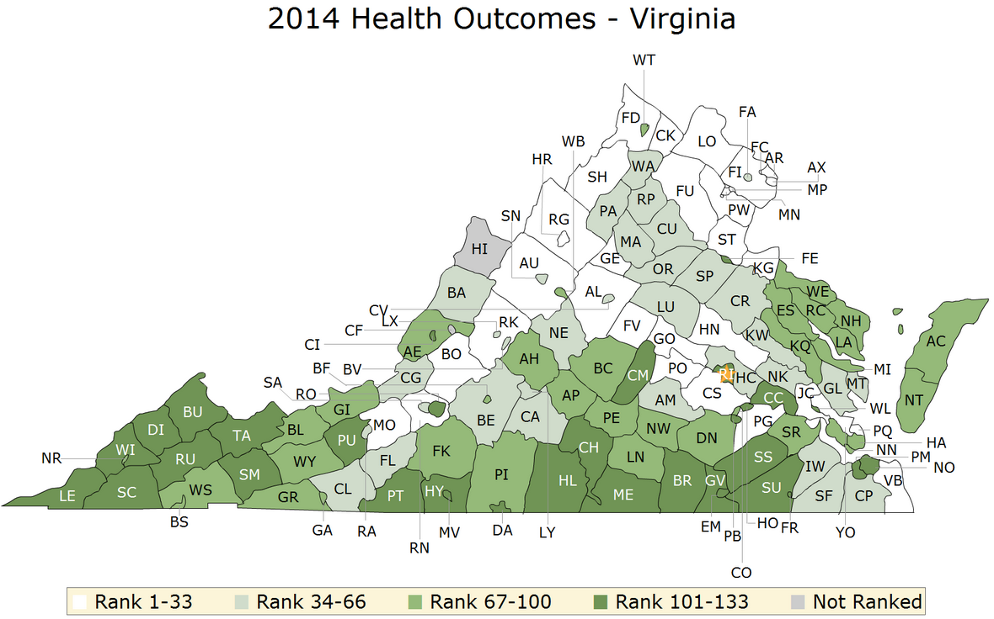
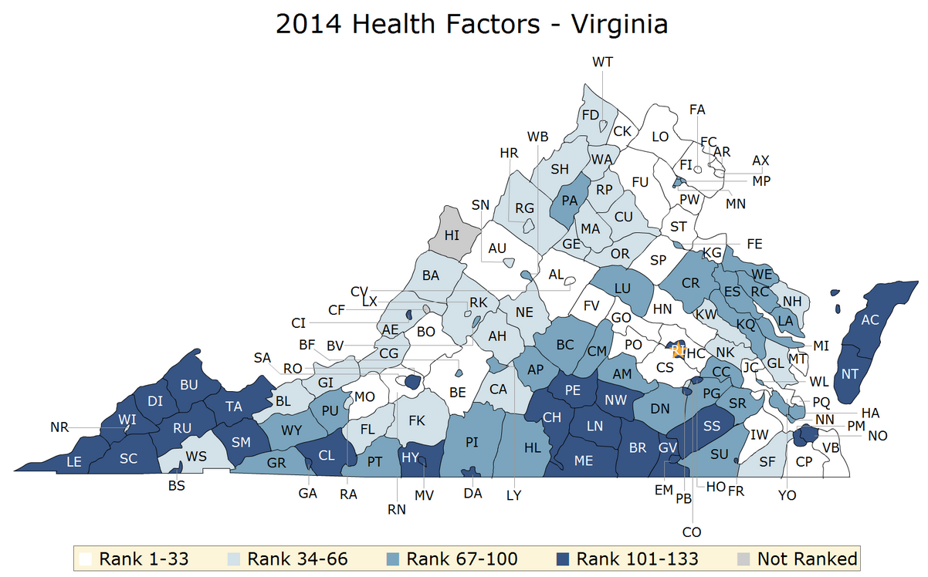
County Health Rankings from Robert Wood Johnson

Slide 15
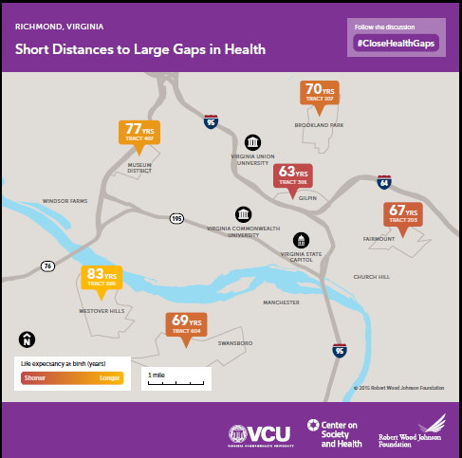

Slide 16
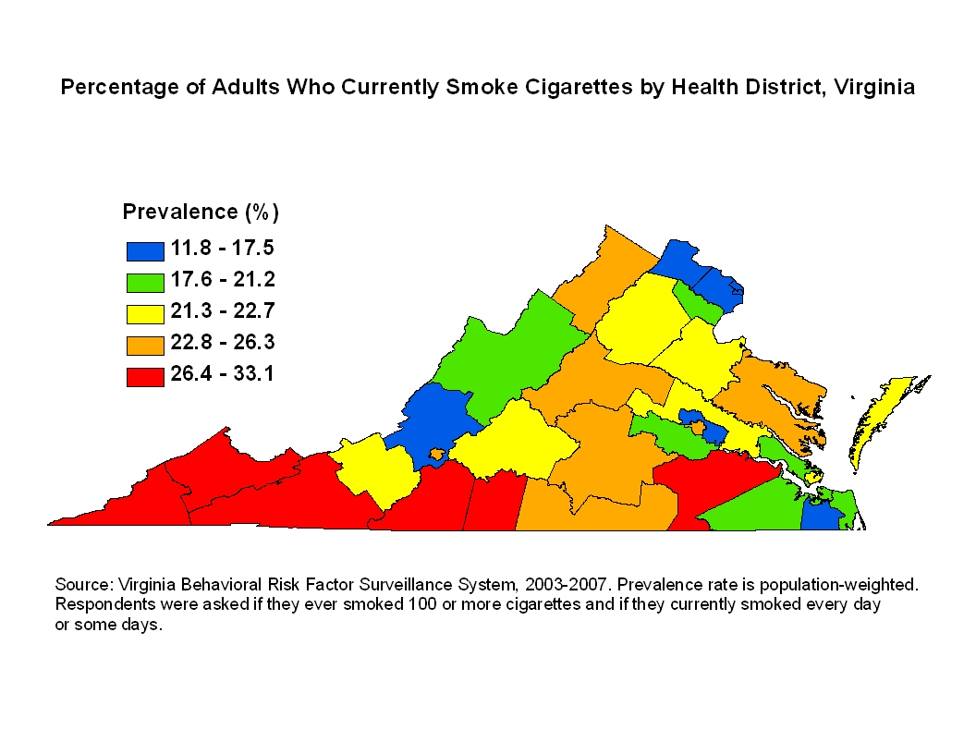

Slide 17
VIRGINIA’S PLAN FOR WELL BEING: An Approach TO DESIGNING HEALTH

Slide 18
Well Being Components: Data Driven
Statewide focus on agreed upon well-being metrics for Virginia – metric alignment
Specific focus on metrics that quantify Virginian’s investment in children’s well being = Strong Start
Other metrics focused on:
Health/Disease Burden (Mortality, Morbidity metrics)
Cost Burden
Notes:
Determinants of Health/Drivers
Recommended Policies
Evidence-based Strategies
Cost
Return on Investment
Key Indicators

Slide 19
CDC Community Health Improvement Navigator

Slide 20
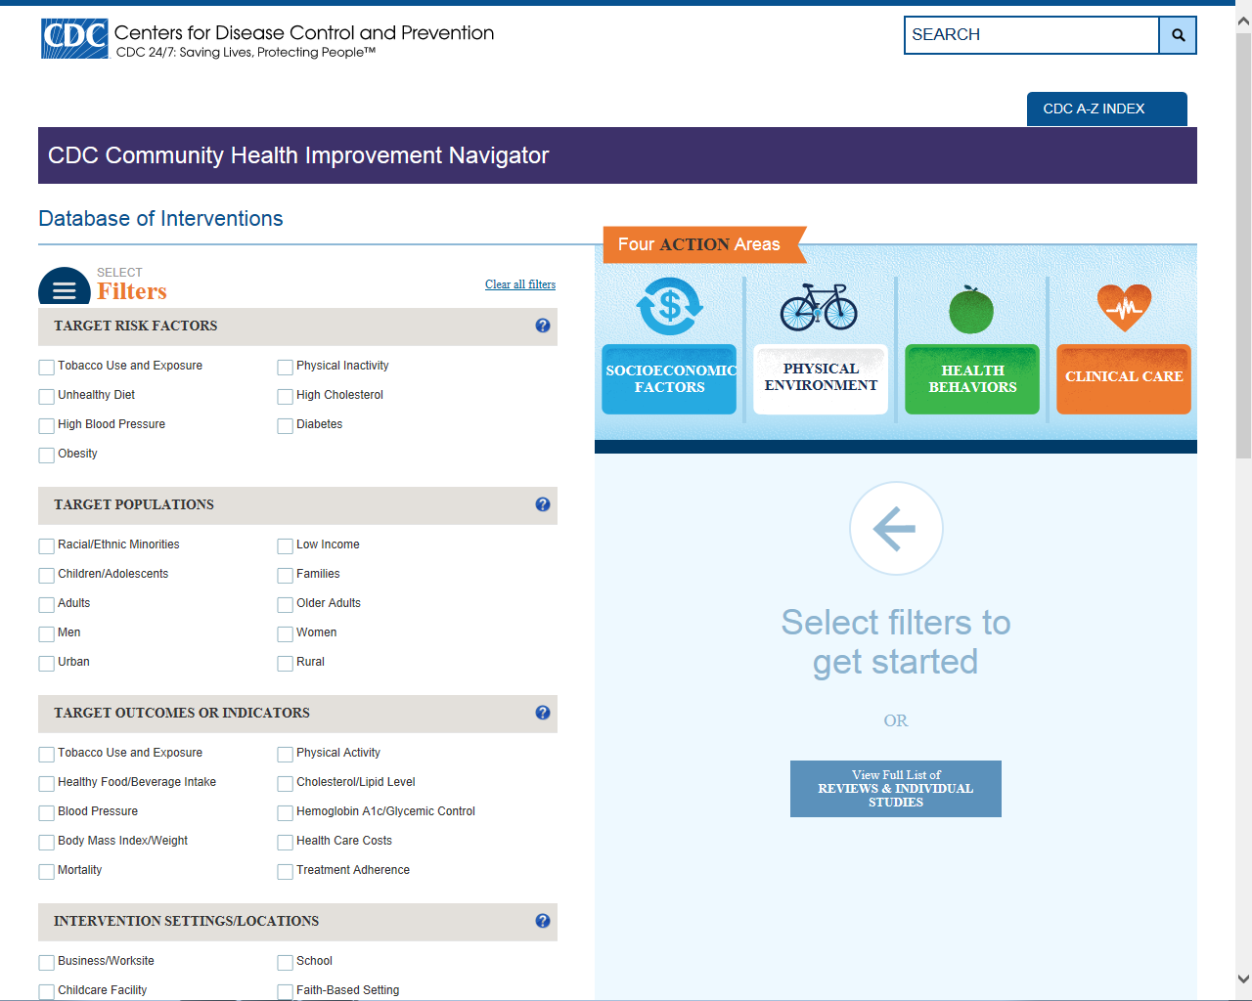

Slide 21
Well Being Components: Process/System Design
Standardized Local/Regional Community Health Assessment
Design a process of coordinated action resulting from assessments/metrics and informed by evidence
Continual evaluation and reevaluation to ensure improvement in health and well being

Slide 22
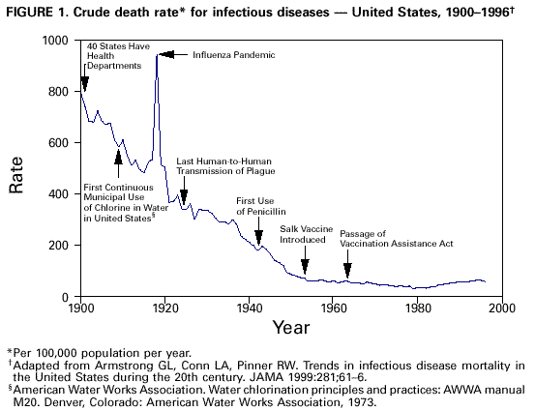

Slide 23
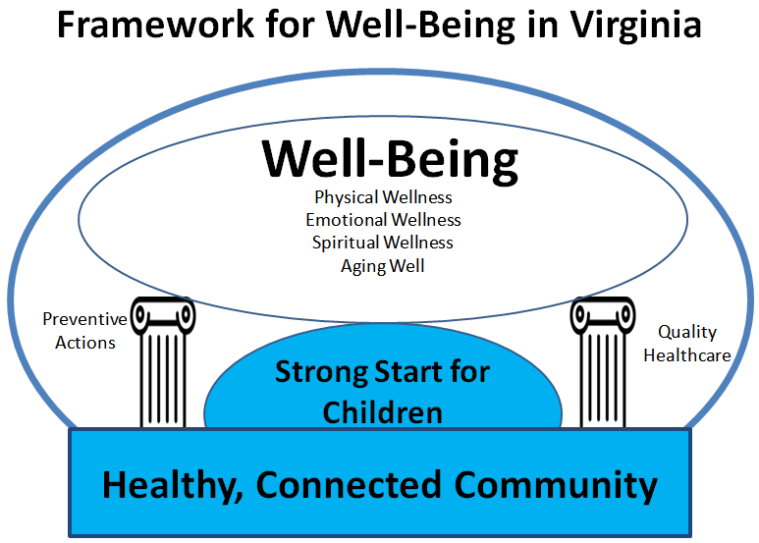

Slide 24
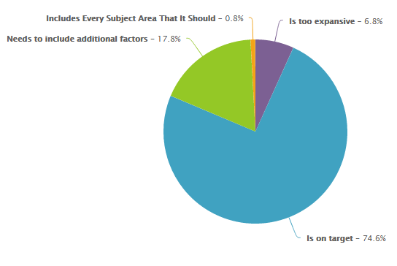
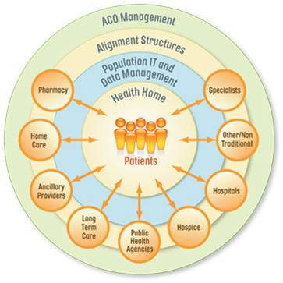
Finalizing Metric Recommendations
1. Surveyed All Parties
2. Presented at ACC Meetings
3. Cross-walked with IOM Report
4. DSRIP
Presented at Each ACC Meeting
Incorporated Recommendations
125 Reponses From Across The State
75% Believe Framework Is On Target
18% Believe Framework Should Be More Expansive
Cross-walked all proposed metrics with IOM
Incorporated Gap Areas

Slide 25
Proposed Metrics
Healthy Connected Communities
STRONG START
Percentage of Infants Surviving Their First Year of Life
Percentage of Children Born At A Healthy Weight
Percentage of Tobacco Free Moms
Percentage of Children Ready for Kindergarten
Percentage of Children Who Achieve 3rd Grade Reading Level
Percentage of Children That Don’t Need a Free Lunch
Health Opportunity Index
Percentage of Population With Access to Nutritious Food
Health Security Preparedness Index
Notes:
Health Opportunity Index – Source: The HOI is comprised of ten indicators that reflect a broad array of social determinants of health within each census tract. Social determinants of health include a range of personal, social, economic, and environmental factors that can contribute to individual and population health. SOURCES include vital statistics and census data.
Percentage of Population With Nutritious Food – Source: 2-stage fixed effect model was created using information from the Community Population Survey, Bureau of Labor Statistics, and American Community Survey.
Health Security Preparedness Index – Source: Comes from a wide range of sources categorized here at http://www.nhspi.org/tools-resources/measure-sources/
Percentage of Infants Surviving Their First Year of Life – Source: Vital Statistics
Percentage of Children Born at a Health Weight – Source: Vital Statistics
Percentage of Tobacco Free Moms – Source: Pregnancy Risk Assessment and Monitoring System (PRAMS)
Percentage of Children Ready for Kindergarten – Source: Percentage of children receiving a passing score on the Phonological Awareness Literacy Screening for Kindergarten (PALS-K) assessment. PALS-K is used to identify students who are below kindergarten-level expectations on important literacy fundamentals.
Percentage of Children Who Achieve 3rd Grade Reading Level – Source: Virginia Standards of Learning (SOL) English examination
Percentage of Children That Don’t Need a Free Lunch: - Source: VDOE National School Lunch Program Free and Reduced Price Eligibility Reports

Slide 26
Aging Well
WELL BEING
Percentage of Population With Advanced Directives
Life Expectancy
Emotional Wellness
Percentage of Population With Sustained Treatment for Depression
Percentage of Population With Follow Up care After Hospitalization for Depression
Physical Wellness
Percentage of Population Living Tobacco Free
Percentage of the Population Free of Cardiovascular Disease
Percentage of Population In a Healthy Weight Range
Notes:
Percentage of Population Living Tobacco Free – Source: Adult Smoking Prevalence— Behavioral Risk Factor Surveillance System Survey (BRFSSS) Data.
Percentage of Population Free of Cardiovascular Disease - Source: Centers for Disease Control and Prevention, National Center for Health Statistics. CDC WONDER On-line Database. wonder.cdc.gov/cmf-icd10.html
Percentage of Population In a Healthy Weight Range - Source: State and Regional Obesity Data: Centers for Disease Control and Prevention (CDC). Behavioral Risk Factor Surveillance System Survey (BRFSSS) Data. Atlanta, Georgia: U.S. Department of Health and Human Services, Centers for Disease Control and Prevention, 2013.
Percentage of Population With Sustained Treatment for Depression - Source: Behavioral Risk Factor Surveillance System Survey (BRFSSS) Data.
Percentage of Population With Follow Up care After Hospitalization For Depression – Source: All Payer Claims Database, DBHS
Percentage of Population With Advanced Directives - VDH Advanced Directive Registry https://www.virginiaregistry.org.
Life Expectancy - Virginia Vital Statistics

Slide 27
Quality Healthcare
WELL BEING
Percentage of Population With Access to Healthcare
Percentage of Population With Diabetes Who had Appropriate Testing & Controlled Blood Pressure
Percent of Avoidable Hospitalizations
Per Capita Health Care Spending
Percentage of the Population With Appropriately Controlled Blood Pressure
Preventive Actions
Percentage of Women Who Received Cervical Cancer Screening
Percentage of Women 50-74 Years of Age Who Had a Mammogram
Percentage of Adults Who Had Appropriate Screening for Colorectal Cancer
Percentage of Population Aged 65+ Receiving An Influenza Vaccination During Sept-Dec.
Percentage of Two Year Olds With Age- Appropriate ACIP Recommended Immunizations
Notes:
Percentage of Women Who Received Cervical Cancer Screening – Source :BRFSS
Percentage of Women 50-74 Years of Age Who Had a Mammogram - Source: BRFSS
Percentage of Adults Who Had Appropriate Screening for Colorectal Cancer – Source: BRFSS
Percentage of Population Aged 65+ Receiving Influenza Vaccination – Source: National Immunization Survey-Flu (NIS-Flu) and Behavioral Risk Factor Surveillance System (BRFSS)
Percentage of Two Year Olds With Age Appropriate ACIP Recommended Immunizations- Source: National Immunization Survey-Flu (NIS-Flu) and Behavioral Risk Factor Surveillance System (BRFSS)
Percentage of Population With Access to Healthcare –Source: National Health Interview Survey (NHIS)
Percentage of Population Appropriately Tested for Diabetes With Controlled Blood Pressure - Source: National Diabetes Statistics Report
Percent of Avoidable Hospitalizations - Source: VHI patient level database system & All Payer Claims Database
Per Capita Health Care Spending – Source: Centers for Medicare & Medicaid Services, Office of the Actuary, National Health Statistics Group. National Health Expenditure Data: Health Expenditures by State of Residence,
Percentage of the Population With Appropriately Controlled BP – All Payer Claims Database, BRFSS

Slide 28
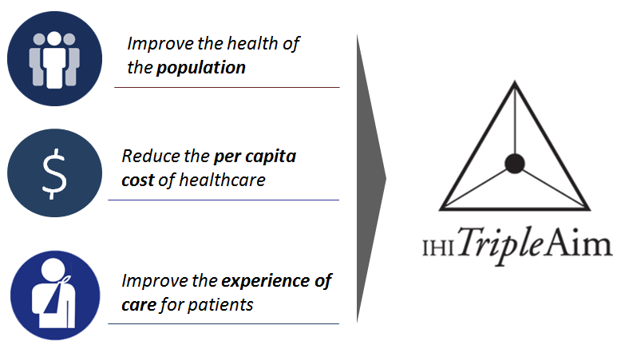
Next Steps
Continue To Refine Metrics And Identify Alternative Data Sources
Focus on ACC Process and DSRIP Integration
Finalize Writing of Plan With Baselines, Goals and Recommended Processes

Slide 29
ASTHO Health Aging Pledge
Collaborative Strategy (DARS and VDH):
Using Data to Understand the Older Adult Population and Drive Action in Virginia
Build Healthy and Safe Community Environments

Slide 30
Using Data to Understand the Older Adult Population and Drive Action in Virginia
Ensure that our local, regional and state community health assessments include a focus on older Virginians

Slide 31
Build Healthy and Safe Community Environments
Assess the role of older adults in a State Transportation
Plan:
Aligns with Complete Streets work and strategies proposed in the walkability grant.
This also aligns with the Virginia GrandDriver initiative funded by DMV through a NHTSA grant, which encompasses the website, www.granddriver.net, CarFit, and "Expanded Older Driver" comprehensive mature driver assessments.
Notes:
including pedestrian and bicycle safety, improve
roadway and driving environment, identify at risk older
adults, improve driving competency, reduce risk of
injury and death of older drivers and passengers

Slide 32
Healthiest State in the Nation
Help us build and implement the “Plan for Well-Being” for Virginia.
Follow the Commissioner on Twitter @VDHCommissioner
Complete the survey at www.vdh.virginia.gov

